Slide 1
Simulated Annealing
Decision Support
2010-2011
Andry Pinto
Hugo Alves
Inês Domingues
Luís Rocha
Susana Cruz

Slide 2
Summary
Introduction to Simulated Annealing (SA)
Meta-Heuristic Concept
Historical Approach
SA Algorithm
Simulated Annealing for the Bin Packing Problem (BPP)
Two Variants of the BPP
Neighborhoods
Parameterization
Computational Results

Slide 3
Introduction to Simulated Annealing: Meta-Heuristic Concept
General methods to be potentially applied to any optimization problem
Contrast with exact and heavy computation algorithms
Find acceptable solutions in admissible amount of time and resources even in real and complex problems
Avoid local minimums by allowing the increase of the cost function under certain conditions
Resemblance to local search methods
Combine multiple heuristics

Slide 4
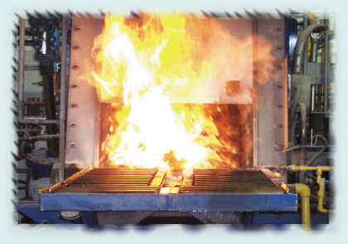
Introduction to Simulated Annealing: Historical Approach
In condensed matter physics, the annealing is the following process:
A solid is heated in a hot bath, increasing the temperature up to a maximum value. At this temperature, all material is in liquid state and the particles arrange themselves randomly
As the temperature of the hot bath is cooled gradually, all the particles of this structure will be arranged in the state of lower energy
Algorithm:
Metropolis et al. (1953), Equation of state
calculations by fast computing machines,
Journal of Chemical Physics , Vol. 21, No. 6
June 1953

Slide 5
Introduction to Simulated Annealing: Historical Approach
Application of these ideas of thermodynamics and metallurgy to optimization problems
Kirkpatrick et al. (1983), Optimization by Simulated Annealing, Science, Vol. 220, No. 4598, May 1983
Cerny (1985), A Thermodynamical Approach to the Traveling Salesman Problem: An Efficient Simulation Algorithm, Journal of optimization theory and applications, Vol. 45, No. l, January I985

Slide 6
Introduction to Simulated Annealing: SA Algorithm
Combinatorial Optimization ⇔ Thermodynamics
Objective function ⇔ Energy level
Admissible solution ⇔ System state
Neighbor solution ⇔ Change of state
Control parameter ⇔ Temperature
Better solution ⇔ Solidification state

Slide 7
Introduction to Simulated Annealing: SA Algorithm
‘When optimizing a very large system (i.e. a system with many degrees of freedom), instead of “always” going downhill, try to go downhill “most of the time” ’ (Kirkpatrick, 1983)
Allows to accept worse solutions
A worse neighborhood solution can be accepted depending on:
Temperature
Difference to the best known solution

Slide 8
Introduction to Simulated Annealing: SA Algorithm
Initial Solution
Generated using an heuristic
Chosen at random
Neighborhood
Generated randomly
Mutating the current solution
Acceptance
Neighbor has lower cost value
Neighbor has higher cost value is accepted with the probability p
Stopping Criteria
Maximum CPU time
Solution with a lower value than threshold
Maximum number of iterations without improvement
Maximum total number of iterations

Slide 9
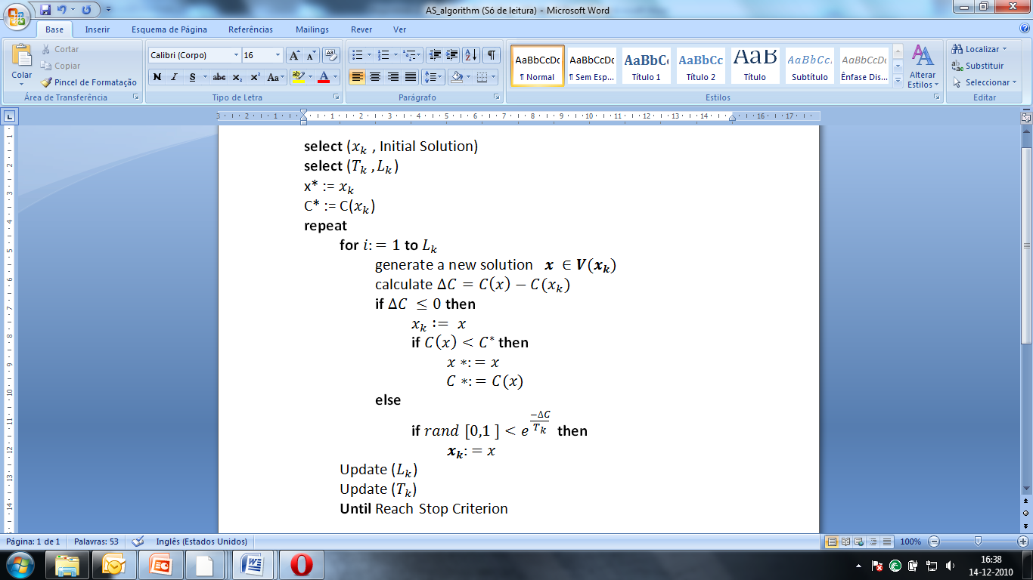
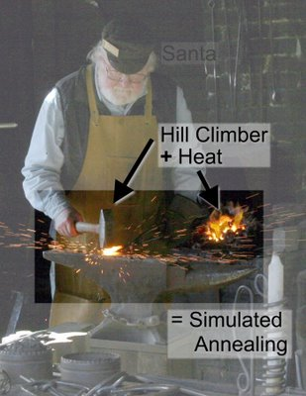
Introduction to Simulated Annealing: SA Algorithm

Slide 10
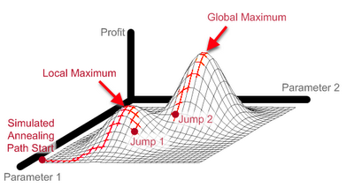
Introduction to Simulated Annealing: SA Algorithm
Geometric cooling: TL+1= β TL
L - Step with in iterations number
T0 – initial temperature (usually high)
β – cooling parameter (usually between 0.8 and 0,99)
ΔC – Difference between current and previous solutions
Probability of acceptance: p = exp (- ΔC/T)
http://www.maxdama.com

Slide 11
Introduction to Simulated Annealing: SA Algorithm
Advantages:
Can escape from local minimum
Simplicity
Robustness
Can be improved by other procedures
Problems:
Parameter tuning
Define initial temperature
When and how to decrease the temperature
Can have long computation times

Slide 12
Simulated Annealing for BPP
Theory and Methodology
Some experiment with simulated annealing techniques for packing problems
Kathryn A. Dowsland
European Journal of Operational Research 68 (1993)

Slide 13
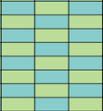
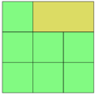
Simulated Annealing for BPP
First Variant (Initial Experiments):
2D BPP with identical pieces
Classical Pallet Loading Problem – Packing identical rectangles into a larger containing rectangle

Slide 14


Simulated Annealing for BPP
Feasible Solutions:
The set of feasible solutions can be considered as any placement of the optimal number of pieces in the containing rectangle
Divide pieces and containing rectangle into a checkerboard of unit square

Slide 15
Simulated Annealing for BPP
The neighborhood structure:
Is a set of solutions obtained my moving any piece to any other position
Two approaches: including or excluding those positions already occupied
The movements may be restricted to those positions with no overlap and excluding the last piece to be moved

Slide 16
Simulated Annealing for BPP
Objective Function:
The main concept is to reduce the overlap between pieces down to the optimal value of zero
Two approaches:
1. Minimize the amount of overlap
2. Minimize the number of overlapping pieces

Slide 17
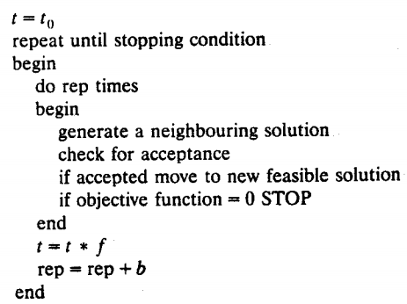
Simulated Annealing for BPP
The Cooling Schedule:
f – cooling schedule
b – iteration step
rep – number of iterations
t – temperature parameter

Slide 18



Simulated Annealing for BPP
The Cooling Schedule - determining temperature:
Cooling function:
Heating function:
Relation:
considered value k=100

Slide 19



Simulated Annealing for BPP
Probability Function:
Usual approach (unsatisfactory):
Proposed alternatives:
Add constant γ
Use linear function

Slide 20
Simulated Annealing for BPP
The Sampling Process
Uniform Random Selection – better solution
Cyclic Sampling Pattern
Starting Solution
Random Solution
Solution from a Fast Heuristic
Optimization Step
Rotate 90º

Slide 21
Simulated Annealing for BPP
Computational Experiments
100 problems from each of the ranges 5-10, 11-20 and 20-30 pieces fitted
Comparison of 8 methods
The annealing process is very successful when 20 or less pieces are to be fitted
Less reliable when 20 to 30 pieces are to be fitted
The schedule with heating up incorporated appeared to be the best with the fixed α:β ratio

Slide 22
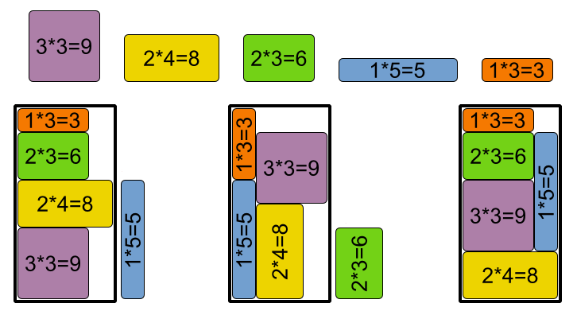
Simulated Annealing for BPP
Second Variant:
2D BPP with non-identical pieces

Slide 23
Simulated Annealing for BPP
Feasible Solutions
Each piece is a valid combination of the lengths or widths of the other pieces types from the container edge
Neighborhood Structure
Move the position of one of the pieces
Restriction: move only overlapping pieces
Restriction: the last piece is not allowed to move

Slide 24
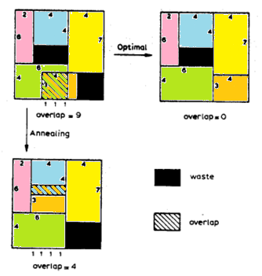
Simulated Annealing for BPP
Objective Function
Minimize the total pairwise overlap weighted according to piece size
Two stages optimization:
Minimize overcover (relaxation of the original problem)
Minimize overlap, constraining overcover to remain zero
Difficult to solve when space is tight

Slide 25

Simulated Annealing for BPP
Cooling Schedule
Same as identical pieces case
Probability Function
Sampling Process
Random solution
Starting Solution
Generate random position for each piece

Slide 26
Simulated Annealing for BPP
Optimization Steps
Swap two pieces that are overlapping
Computational Experiments
20 problems
5 sets of piece dimensions packed into 4 different widths
Annealing in parallel produced the most promising results

Slide 27
Simulated Annealing for BPP
Conclusions
Use of a cooling schedule which also heats up when moves are not accepted
Use of a relaxed objective either in a two stage approach or in parallel
Capability to produce “near” solutions - transformed into solutions by hand

Slide 28
Simulated Annealing
?
Questions

